Slide 1
Cybersecurity Suspicious Web Threat Interactions
Created by: Divya Krishnakumar
Type of project: Internship Project
Tools Used: Python, SQL
Submitted to: Unified Mentor Pvt. Ltd
Date: 24/07/2025

Slide 2
Executive Summary
The aim of the project is to detect anomaly or unusual behaviours in web traffic. The methodology followed in this project consists of the following steps – Data collection, Data wrangling, Data analysis, Data visualisation, Feature engineering, Model building, Model Evaluation.
Data is collected and read to a data frame and subjected to descriptive statistics to understand the data. The dataset provides web traffic details of suspicious activity which can be used by data scientists to detect threats. Each row of data set represents a stream of traffic to a web server. The columns were bytes_in, bytes_out, creation_time, end_time, src_ip, src_ip_country_code, protocol, response.code, dst_port, dst_ip, rule_names, observation_name, source.meta, source.name, time, detection_types. As a part of data wrangling the columns are renamed to relevant names. The columns with irrelevant data types are converted to relevant data types. Then the dataset is checked for null values and duplicates.
Data is analysed with SQL. Data is analysed for further insights with data visualisations. The transactions of unusual behaviour is found out. The columns Session_Duration and Average_Packet_Size are created through feature engineering for prepare for model development. A model is developed with IsolationForest algorithm and fitted and predicted with X. The results are visualised with scatter plot. A classification report is printed to evaluate the model. A confusion matrix is plotted to evaluate further. The results are stored in a .csv file.

Slide 3
Introduction
The project aims to identify patterns of unusual behaviour in the web traffic. This involves analysis of dataset to detect anomaly in the web traffic.
The key questions are:
Which streams of web traffic are anomalous?
From which IP’s suspicious activities originated?
Which are the 10 source IP’s from where maximum times suspicious activities are found?
What is the total number of bytes in for suspicious activity?
What is the total number of bytes out for suspicious activity?
What are the unique Src_IP_Country_code from where suspicious activities are found?
What is the proportion of suspicious activities from different countries?
What are the minimum bytes in and bytes out for suspicious traffic?
What is the trend of suspicious traffic at different times?

Slide 4
Methodology
Data is collected and loaded to a data frame. The methodology used in this project has following steps: Data collection, Data wrangling, Data analysis, Data visualisation, Feature engineering, Model building, Model Evaluation.
The data collected is cleaned, analysed, visualized and subjected to machine learning algorithm, IsolationForest.
Data Collection: Data is collected and loaded to a dataframe. The data set consists of columns such as bytes_in bytes_out, creation_time, end_time, src_ip, src_ip_country_code, protocol, response.code, dst_code, dst_ip, rule_names, observation_name, source.meta, source.name, time, detection_types.

Slide 5
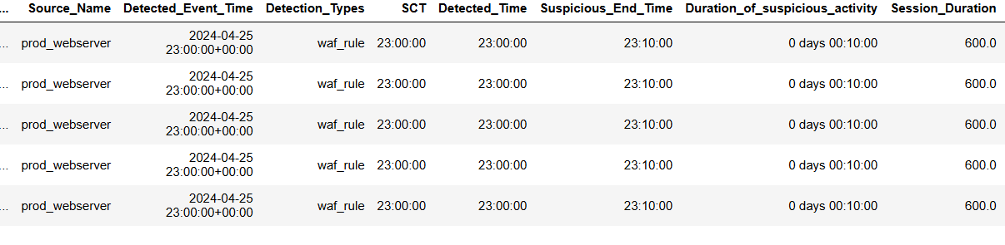
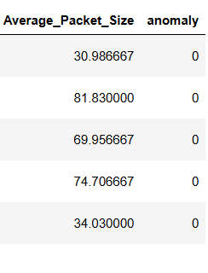
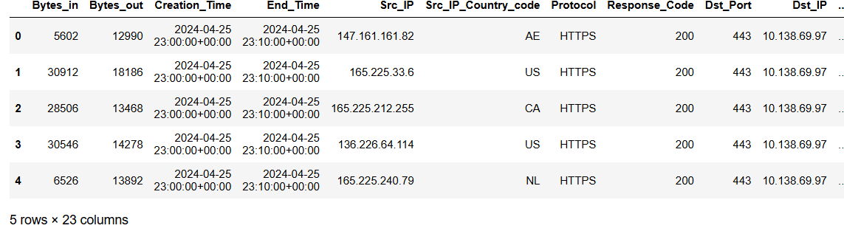
Data Wrangling
During this step the columns are renamed to relevant column names. The data types of columns are changed to relevant data types. The data set is checked for missing values and duplicates and found no missing values and duplicates. The data frame thus obtained is as follows:

Slide 6
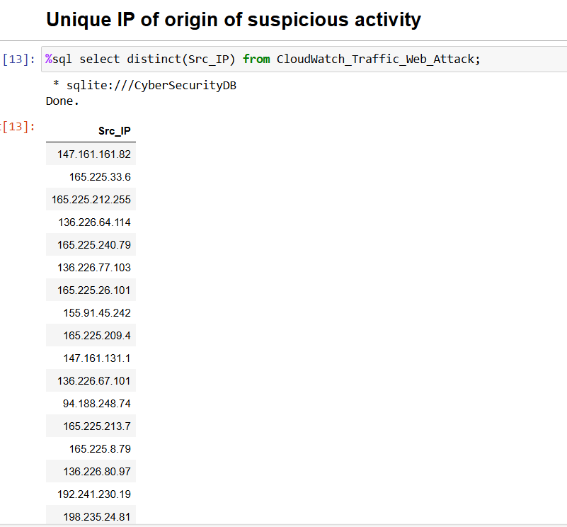
Data Analysis with SQL results
Anomalous rows for Bytes_in and Bytes_out are displayed by finding IQR and using IQR rule. The dataset is then subjected to SQL analysis. The following are insights from SQL analysis.

Slide 7
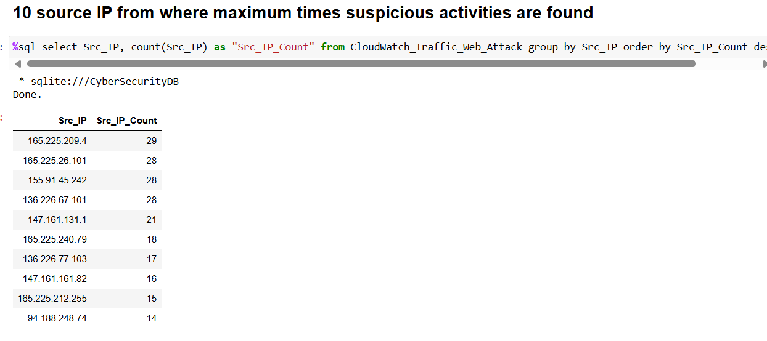
Data Analysis with SQL results

Slide 8
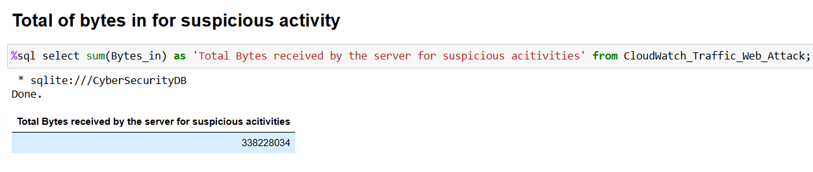
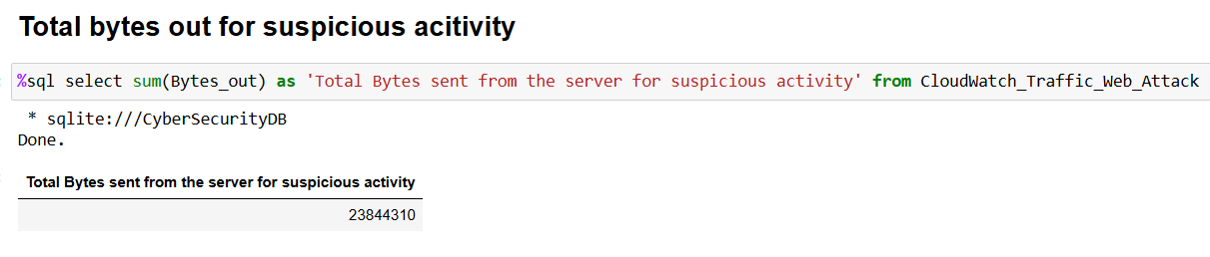
Data Analysis with SQL results

Slide 9
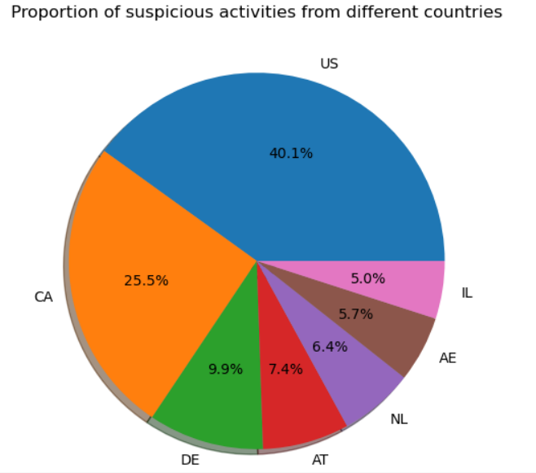
Exploratory Data Analysis and Visualisation

Slide 10
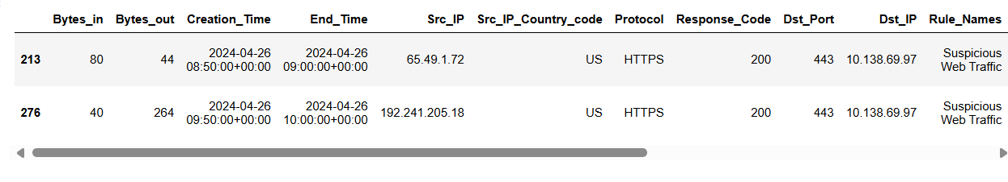
Exploratory Data Analysis and Visualisation

Slide 11

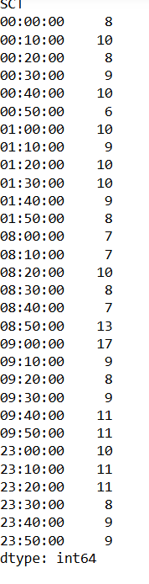
Exploratory Data Analysis and Visualisation

Slide 12
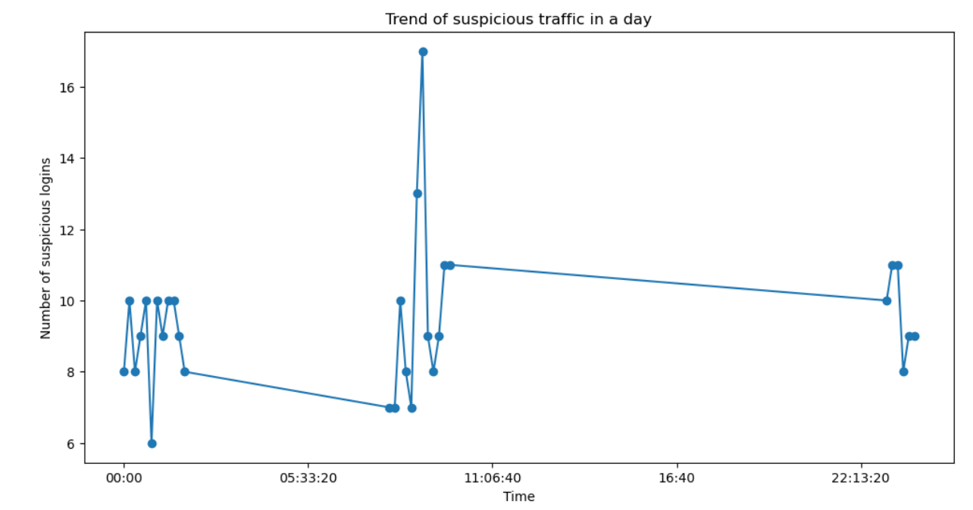
Exploratory Data Analysis and Visualisation

Slide 13
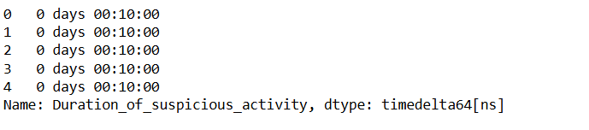
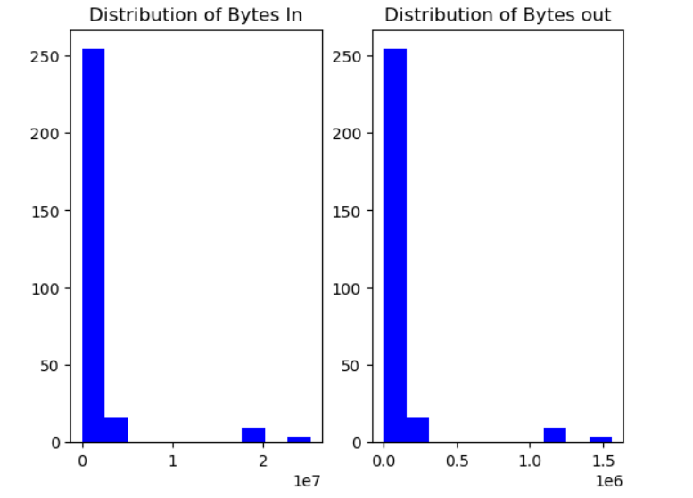
Exploratory Data Analysis and Visualisation
Duration of suspicious activity
Distribution of bytes in

Slide 14
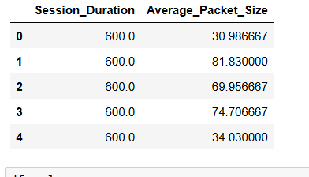
Feature Engineering
Session duration and average packet size are the newly created features. Session duration is the difference between session end time and session creation time. Average packet size is the sum of bytes_in and bytes_out divided by session duration.

Slide 15
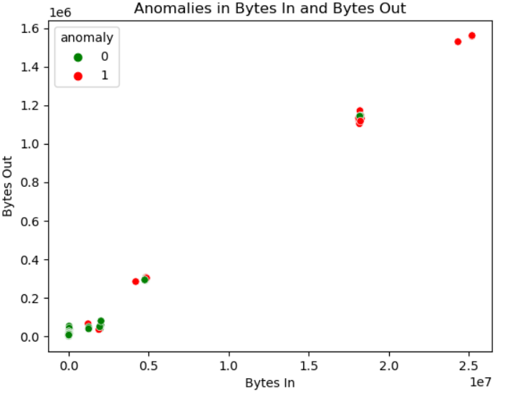
Model Building
A model is developed with machine learning algorithm IsolationForest. The model is initialised, fitted and predicted with train data set to predict unseen data.
The results of model development is visualised with a scatter plot. The scatter plot is as follows:

Slide 16
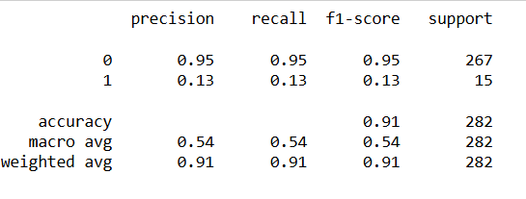
Model Evaluation
The model is evaluated with displaying a classification report.
The accuracy score of the model is 91%. The classification report is as follows:

Slide 17
Findings and Implications
Total bytes in for suspicious activity is 338228034.
Total bytes out for suspicious activity is 23844310.
The maximum bytes in for suspicious traffic is 25207794.
The minimum bytes out for suspicious traffic is 44.
Duration of suspicious activity is 10 minutes.
For 267 non anomalous activities 15 suspicious activities could occur.
The suspicious activities are during 9:00 hours to 10:00 hours and 23:00 hours to 23:50 hours.
The maximum times the suspicious activities are from the unique id 165.225.209.4 and number of times is 29.
The country codes of maximum suspicious activities are from US, CA.

Slide 18
Conclusion
The anomaly is detected in the web traffic by inspecting the number of bytes transferred. If the bytes transferred is unusually high it indicates suspicious activity. The web traffic of suspicious activity indicates that the attacks could be bot attacks. There are about 37 to 40 suspicious attempts. These suspicious attempts from same IP address have huge bytes transferred indicating bot attacks. The maximum of bot attacks are from the country code US.
From the predictive analysis we can conclude that for every 280 activities there could be 15 suspicious activities.
Future implications and suggestions:
The suspicious attack can be identified and prevented by using defense bots which work round the clock, scanning systems and networks. It will raise alerts or take automated actions if any suspicious activity is detected.
AI powered bots can be used to identify and prevent anomalous threats.

